Slide 2
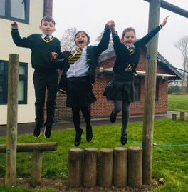
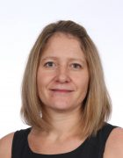
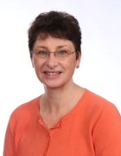
Welcome to year 5
Our Team
Mrs Pilkington
Mrs Jeneson
Teaching
Assistant
Miss Diamond
Music, Science & PE
Mr Whitham
PE &
Health
Miss Whittaker
Schools Direct

Slide 3
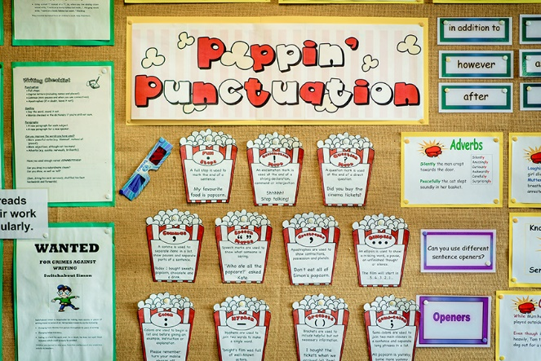
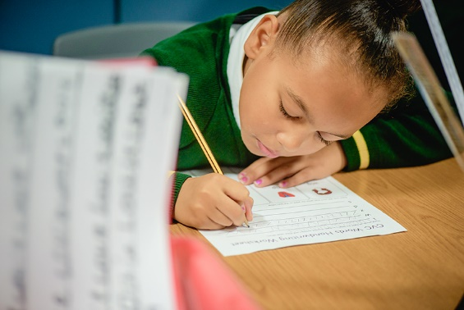
Supporting the transition back to school
Routine and Normality
Hygiene measures
Additional measures
Early assessments & Intervention
Supporting Wellbeing

Slide 4
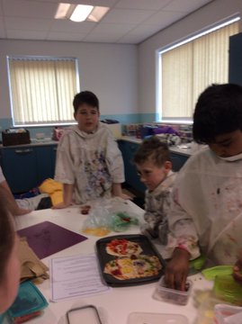
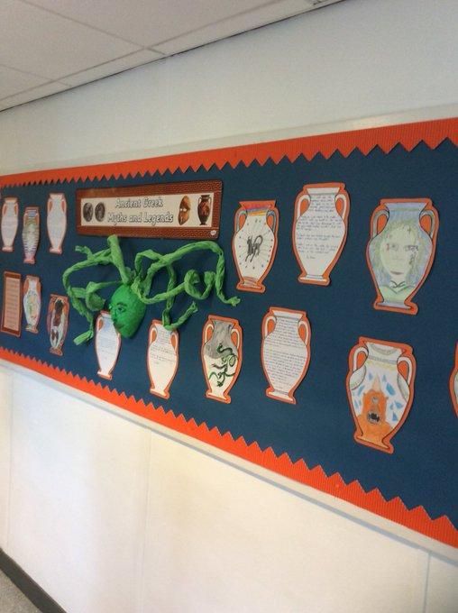
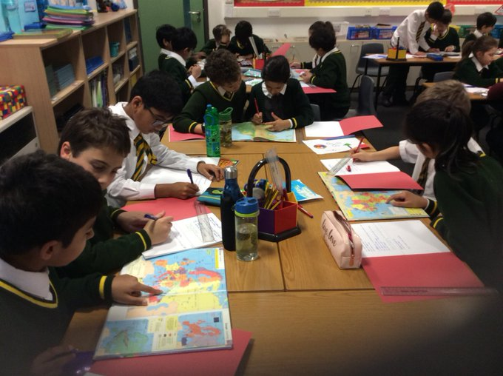
Exciting Topics To Look Forward to
History – Local History
Geography – Maps & orienteering
DT – Marble Run
Science - Space

Slide 5
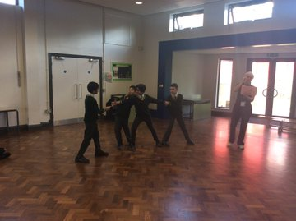
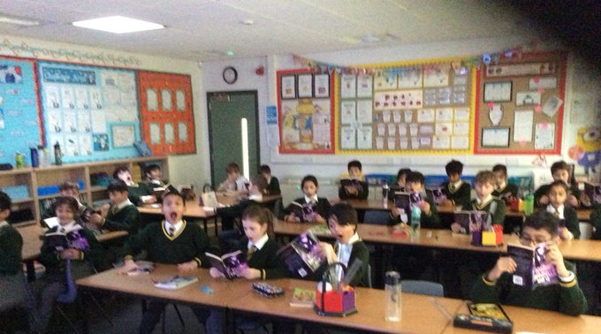
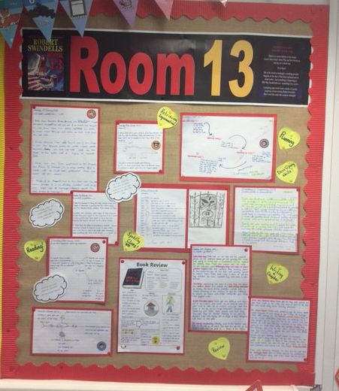
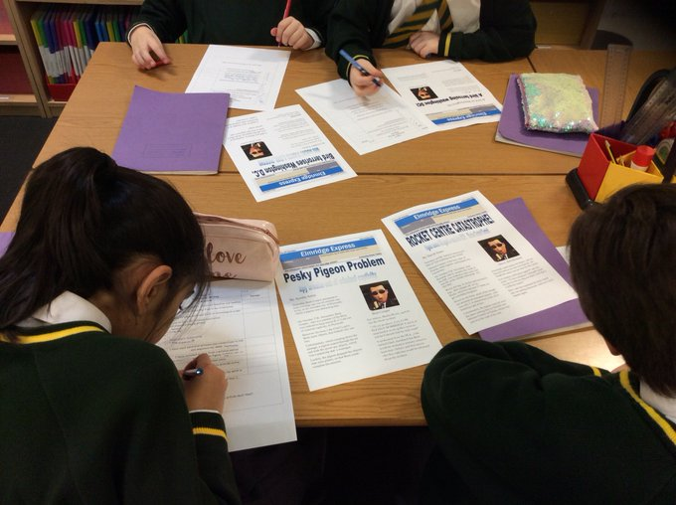
English
Catch up sessions
Shakespeare project
Class Novel
Journalism

Slide 6
Reading
There is no such thing as a child who hates to read; there are only children who have not found the right book. —Frank Serafini
You may have tangible wealth untold; caskets of jewels and coffers of gold. Richer than I you can never be. I had a mother who read to me. —Strickland Gillian
Reading should not be presented to children as a chore or duty. It should be offered to them as a precious gift. —Kate DiCamillo
We are keen to keep raising the profile of reading.

Slide 7
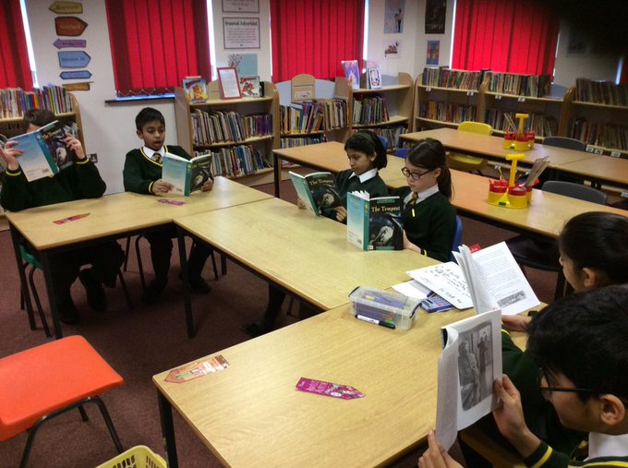
Reading In School Reading At Home Recording Reading

Slide 8
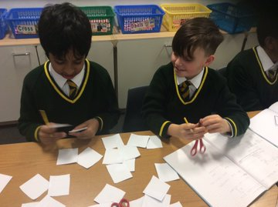
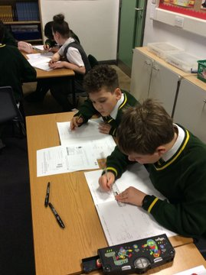
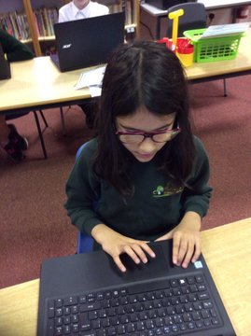
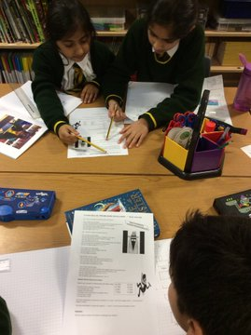
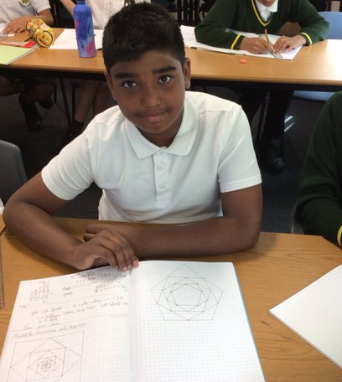
Maths in School Catch up sessions At Home Challenge Club

Slide 9
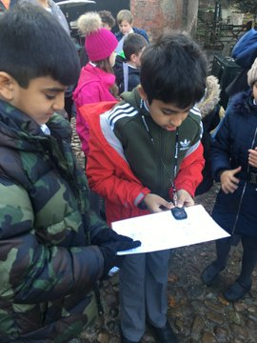
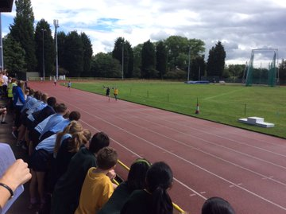
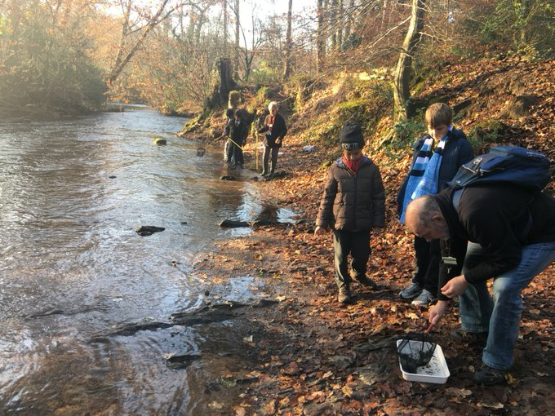
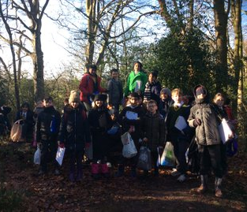
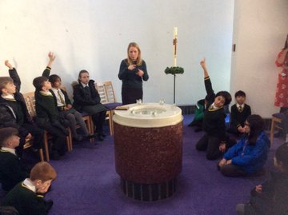
Events and Trips
Swimming?
Quarry Bank Mill
Locality visits

Slide 10
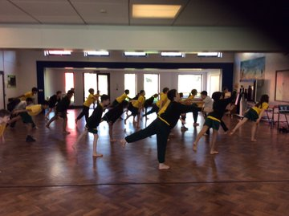
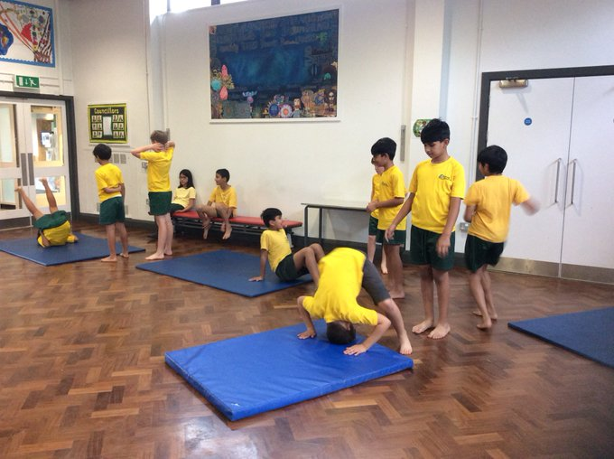
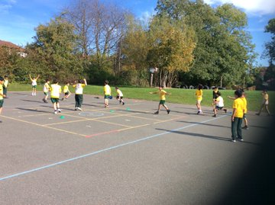
Physical Education
Timetable – Mon & Tuesday
Kit should be worn on PE days instead of uniform
Unable to participate - email
Daily Mile
Additional PE - Thursday tbc

Slide 11
Class Timetable
Available on our
class webpage

Slide 12
Morning Routine
Please arrive at school via the entrance on Wilton Drive.
Children should arrive in the school playground for 9:05 am and queue using markings in the playground at the KS2 door.
If a sibling has an early drop off slot then your child may arrive at that earlier time and follow the same guidelines.
We would ask parents not to wait with their children but to then exit school via rear entrance following the one way system.
You may need to speak to your child’s class teacher, but due to social distancing, please refer to communication lines or visit the office if there is an urgent message.
Use of the school field or any equipment is not permitted
Please only arrive at your allocated time slot and we would appreciate your punctuality.

Slide 13
End of the Day
Please arrive at school via the entrance on Wilton Drive.
Children can be collected from the KS2 door at 3:25.
If a sibling has an early pick up time then your child will be ready to meet you at the KS2 door at this time.
We would ask parents not to wait with their children but to then exit school via rear entrance following the one way system.
You may need to speak to your child’s class teacher, but due to social distancing, please refer to communication lines previously discussed or visit the office if there is an urgent message.
Use of the school field or any equipment is not permitted
Please only arrive at your allocated time.

Slide 14
Equipment
A small school bag to carry packed lunch, water bottle and reading and homework books.
No pencil cases or other equipment is necessary.
A labelled water bottle.
PE kit is worn on the day to school for PE.
Packed lunch in a disposable wrapper
More outdoor opportunities – coat or sun cream as required.

Slide 15
Homework Timetable –
Available on our
class webpage.
Help and support
ideas and resources
can be found on our
Class webpage.
SeeSaw
Espresso
BBC Bitesize
Day | Work to be completed | When this is to be handed in
Monday | Spellings and English task Reading Hand in Maths | Hand in on Friday Please write pages read in the reading record section of your PAL
Tuesday | Science task Reading | Hand in on Friday Please write pages read in the reading record section of your PAL
Wednesday | Maths Reading | Hand in on Monday Please write pages read in the reading record section of your PAL
Thursday | Reading Ask parents to sign your PAL | Please write pages read in the reading record section of your PAL
Friday | Reading Hand in English, Science and PAL | Please write pages read in the reading record section of your child’s PAL

Slide 16
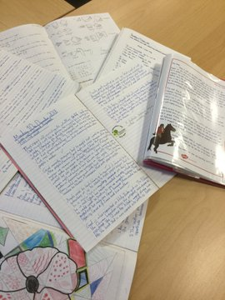
Presentation

Slide 17
Expectations and Opportunities
Independence
Golden Rules
Class Contract
Responsibilities
Representing the school

Slide 18
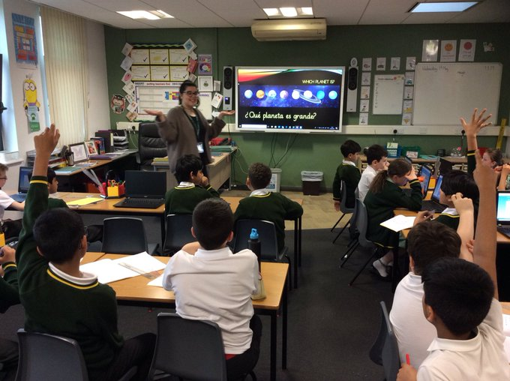
Assessment in Year 5
Ongoing assessment
Optional SATs
NFER testing

Slide 19
Communication
Please inform me if you feel there are any emotional or physical circumstances that may affect your child.
Ways to contact me:
1) Class email account Year5@elmridge.trafford.gov.uk
2) By phone – the office will be able to put you through or arrange for me to call you or make an appointment
3) Note in your child’s PAL (These are checked weekly)
4) Seesaw
We are aiming to cut back on the excess paper used in school. If you have access to email it would be helpful if we could email letters to you.
School website is useful for keeping up to date with events. http://www.elmridge.trafford.sch.uk/

Slide 20
Twitter - A great way to keep in touch
SCHOOL TWITTER ADDRESS
@ElmridgeSch
CLASS TWITTER ADDRESS
@ElmridgeSchY5

Slide 21
Reminders School uniform and haircuts Labelling property Healthy School Walking to school Wrap around care Class WhatsApp

Slide 22
Home School Agreement
Pledges for the parent(s) or guardian(s): I/we promise that, having chosen Elmridge Primary School, I/we will accept the school’s overall aims and objectives, and positively support the class teacher.
I/we will endeavour to:
Ensure regular attendance and punctuality, and provide explanations for absence
Support high standards of work and behaviour
Ensure that the school has up-to-date information for emergency contacts
Keep the school informed on end-of-day child collection arrangements, and support the code of conduct, which seeks to guarantee a caring, secure and disciplined environment
Let the school know of any problems which might effect work or behaviour
Attend parent-teacher consultations about attainment and progress
Encourage homework and other opportunities for home learning
Support school community events
Support all school policies

Slide 23
Free School Meals/Pupil Premium
All children in Reception, Year 1 and Year 2 automatically get free school meals ‘Universal Free School Meal’
From Year 3 onwards a free school meal is income-related
All children from Reception to Year 6 may be eligible for a free school meal
Receipt of free school meal results in school receiving pupil premium funding currently of £1300 per pupil per year, the money must contribute to ‘raising the attainment of disadvantaged pupils & closing the gap with peers’
Pupil Premium funding still needs to be claimed even if your child is receiving the Universal Infant Free School Meal in Reception, Year 1 or Year 2 classes
To apply you will need to share your National Insurance details with school. This can be used by school to check whether your child is eligible for the pupil premium funding
School must have written permission from parents to use their information
Check with the school office if you feel you may be eligible

Slide 24
Key Stage Fund
I would like to take this opportunity to thank those of you who have made a contribution to our Key Stage Fund in previous years.
As a Key Stage we really do appreciate your kindness and we put a great deal of thought into how to spend the money in order to achieve the maximum impact for your children.
At Elmridge we pride ourselves on our high quality learning opportunities that meet both the needs and interests of the children. These activities often rely heavily on practical resources. The fund also helps to provide additional resources and materials for developing the children’s creative side.
We are inviting parents to make a voluntary contribution of £5 per term to help to contribute to these resources. This is a total of £15 for the school year and works out at less than 50p per week of school. This donation can be made via your ParentPay account. If you are unable to pay by ParentPay then donations can be made in cash, or by cheque made payable to ‘Elmridge Primary’.

Slide 25
Any Questions?

